Slide 1
Notes:
Hello and welcome!
The purpose of this presentation is to provide an overview of the alliance between Rotary and Toastmasters and to share how you and your club can participate.

Slide 2
The Alliance
Learn More
Get Involved
Notes:
In this session, we'll cover the goals of the alliance, learn more about Rotary, and share ways you can get involved.

Slide 3
The Alliance
Notes:
Let’s start by talking about the alliance.

Slide 4
Personal and Professional
Growth Opportunities
Notes:
Our organizations are working together to enhance the member experience by providing each of our members with more opportunities for personal and professional growth.
Being able to express yourself confidently in front of an audience is a learned skill that has immense benefits, personally and professionally, in the office, at the club, and even at home. Sharing our stories can inspire others and build community. By expanding our personal and professional skills, we are creating lasting change within ourselves, and by doing so, we are better able to serve our clubs and our communities.

Slide 5
Benefits
ROTARY
TOASTMASTERS
New leadership development curriculum
Increase collective impact
Connect with more people
Opportunities for Service Speaking Learning Membership
Networking Activities
Take advantage of new speaking and learning opportunities
Enhance fellowship and connections
Build stronger clubs
Make a difference in your community
Notes:
Our alliance offers benefits to members of both organizations.
Members of Toastmasters will be able to connect with more people, take advantage of new speaking and learning opportunities, and use their skills to make a difference in their communities with Rotary. For example, we recently heard about a Toastmasters member who developed a relationship with his local Rotary club, which led to him leading a public-speaking workshop for Rotarians. He was excited to use his expertise to help others, while practicing his communications skills with a new and bigger audience.
Members of Rotary will have a new leadership development curriculum to help develop and improve their leadership and communication skills, provide opportunities to enhance their fellowship and connections, build stronger clubs, and increase their collective impact by collaborating with their Toastmasters clubs.
Both organizations will benefit from increased service, speaking, learning, and membership opportunities, as well as increased networking activities.

Slide 6
Learn More About Rotary
Notes:
Now, let’s learn more about Rotary.

Slide 7
What is Rotary?
Notes:
Like Toastmasters, Rotary is also an international organization of clubs. Rotary members join together to solve problems in their communities and make a difference in the lives of others. Their #1 priority is eradicating polio worldwide. Rotary has been working to eradicate polio since 1988. Since then, Rotary and its partners have reduced polio cases by more than 99.9% worldwide.

Slide 8
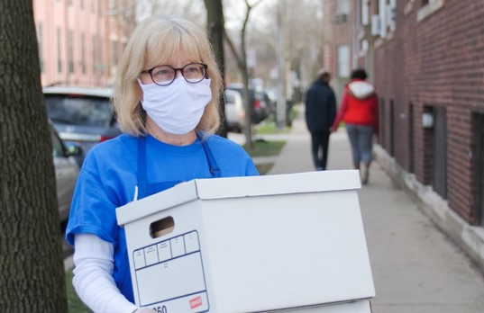
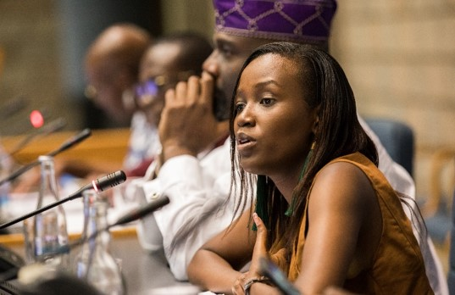
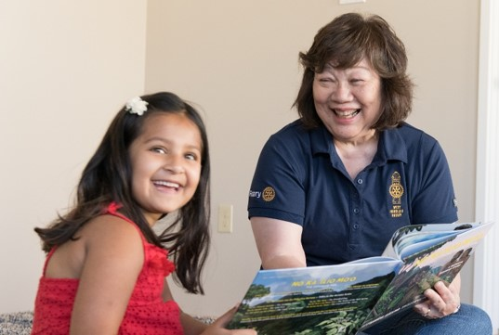
Rotary’s Causes
Peacebuilding and conflict-prevention
Disease-prevention and treatment
Water, sanitation, and hygiene
Maternal and child health
Basic education and literacy
Community economic development
Notes:
Rotary members believe they have a shared responsibility to take action on our world’s most persistent issues. Their 36,000+ clubs work together to:
Promote peace
Fight disease
Provide clean water, sanitation, and hygiene
Save mothers and children
Support education
Grow local economies
Members can apply for global grants for projects that fall into one of these areas of focus. Their mission is, “We provide service to others, promote integrity, and advance world understanding, goodwill, and peace through our fellowship of business, professional, and community leaders.”

Slide 9
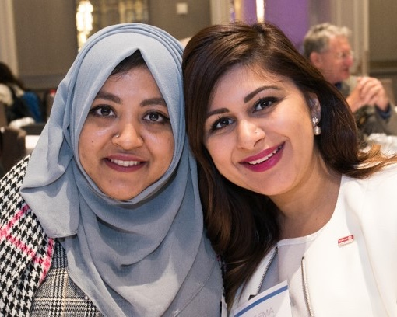
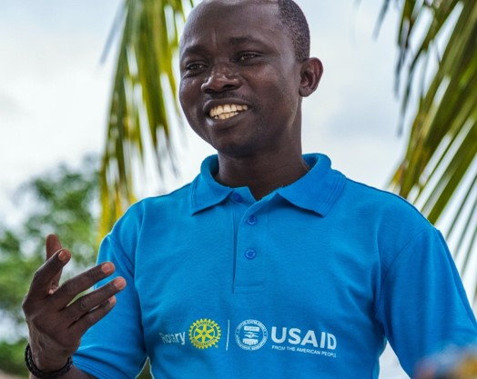
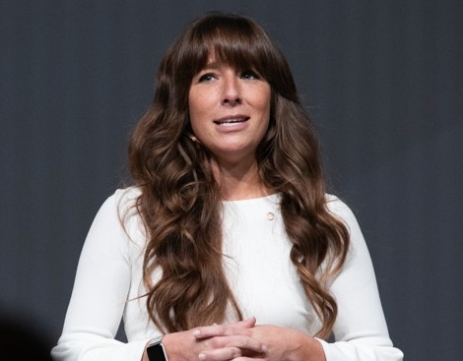
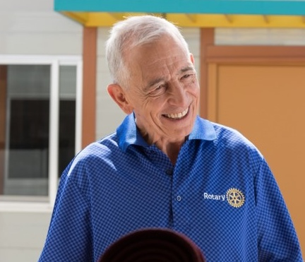
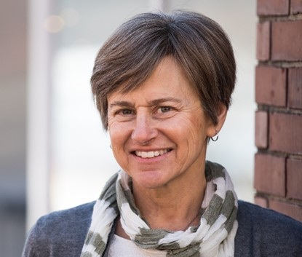
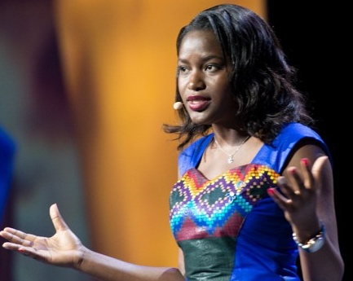
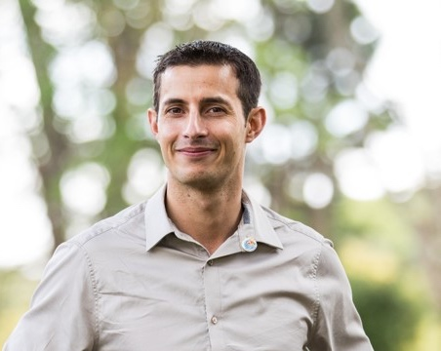
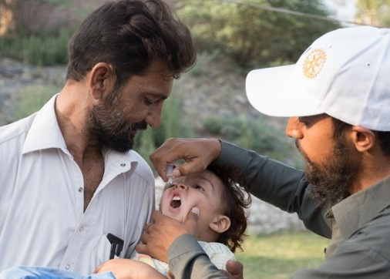
Rotary Members
Notes:
Rotary's 1.2 million members are neighbors, friends, leaders, and problem-solvers who see a world where people unite and take action to create lasting change – across the globe, in their communities, and in themselves.
Rotary members are called Rotarians. The criteria for being a Rotarian are simple: Be an adult who demonstrates good character, integrity, and leadership; have a good reputation within your profession and community; and be willing to serve in the community or around the world.

Slide 10
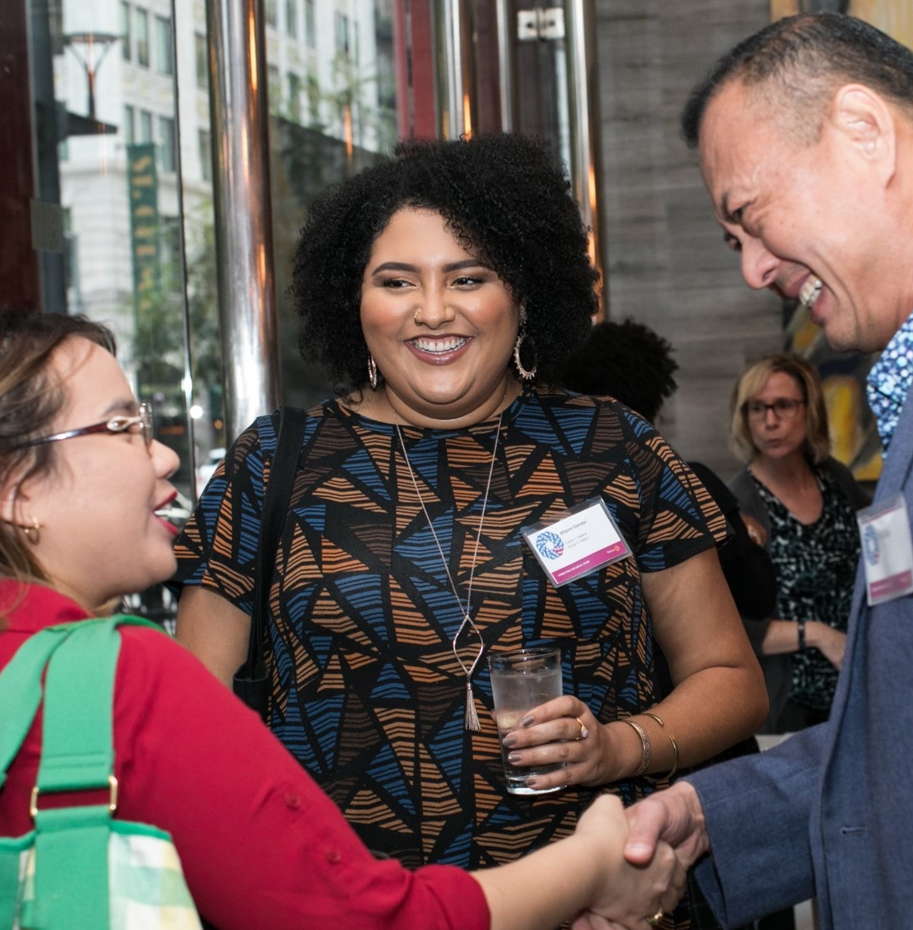
Clubs
Rotary Clubs
Rotaract Clubs
Interact Clubs
Notes:
Rotary clubs are where members come together to strengthen their connection with friends and neighbors and their commitment to improving lives. They are all grounded in the same values, but each one is unique, because each community has its own unique needs.
Rotary's clubs for young leaders are called Rotaract clubs, and their members are Rotaractors. Rotaract clubs meet to exchange ideas with leaders in the community, develop leadership and professional skills, and have fun through service. Historically for young leaders ages 18-30, Rotaract is now open to members of any age and no longer need a Rotary club to sponsor them.
Interact clubs connect people ages 12-18 with others in their community or school to learn about the world through service projects and activities. They are sponsored by their local Rotary clubs.
Many clubs are adapting to online meetings as needed.

Slide 11
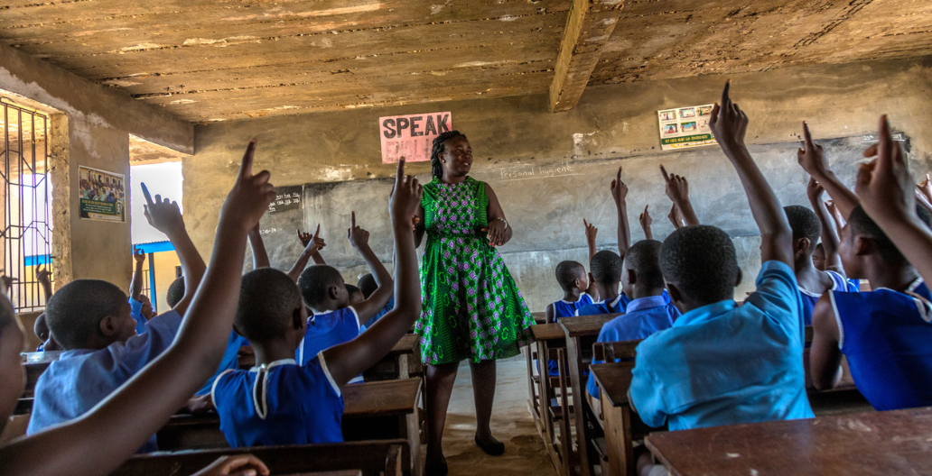
The Rotary Foundation
Notes:
The Rotary Foundation helps fund humanitarian activities, from local service projects to global initiatives. Since it was founded more than 100 years ago, it has funded more than $4 billion in life-changing, sustaining projects.
The mission of The Rotary Foundation of Rotary International is to enable Rotarians to advance world understanding, goodwill, and peace through the improvement of health, the support of education, and the alleviation of poverty.
Pictured here is a teacher instructing her classroom on personal hygiene practices at a school in Ghana. Rotarians from 35 clubs across the country are partnering with USAID and national and local agencies of the government of Ghana in a large-scale $4 million program in water, sanitation, and hygiene project serving 75,000 people.

Slide 12
Organizational Structure
Club Leaders
Assistant Governor
District Committees
District Governor
Regional Leaders
Board of Directors and Board of Trustees
Club Leaders
Area Director
Division Director
District Director
Region Advisors
Board of Directors
Notes:
As you can see, our organizations are structured very similarly, from club leaders all the way up to the Board of Directors. We both value leadership and the impact one can make with strong leadership skills.

Slide 13
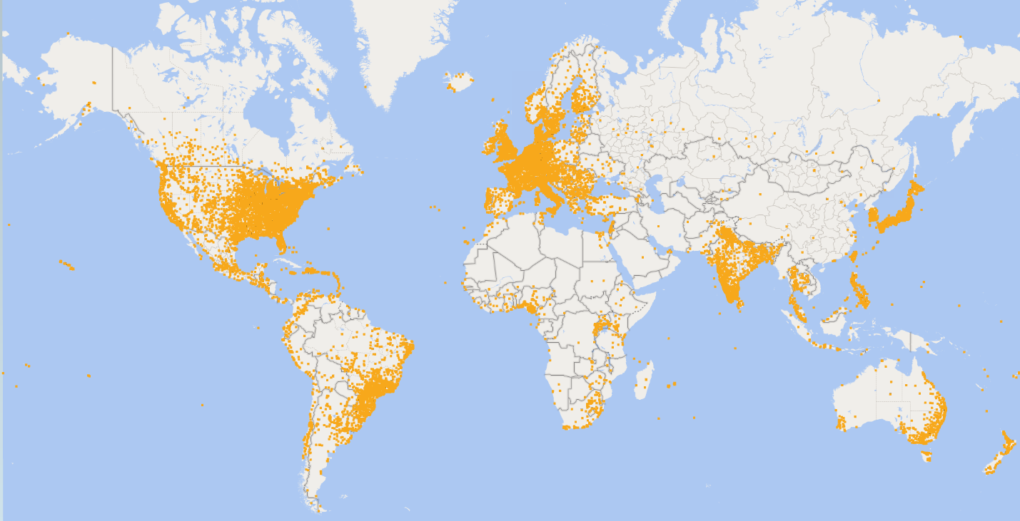
Worldwide Presence
Notes:
Rotary members are all over the world, just like Toastmasters. There are more than 1.2 million members in 36,087 clubs in countries all over the world.
The similarities between our organizations and worldwide presence are what led to the development of our alliance.

Slide 14
Get Involved
Notes:
You may be wondering how to start getting involved with this alliance.

Slide 15
Rotary Courses
Developed by Toastmasters
Leadership and communication skills
Rotary’s Learning Center
Notes:
Rotarians are receiving online leadership and communication courses, developed by Toastmasters for Rotary as part of the alliance. The courses being developed for Rotary are based on the Toastmasters’ Pathways curriculum, but they are not the same. These courses are specifically for Rotary and take content from various paths in Pathways, already available to Toastmasters.

Slide 16
Course Topics
Develop a speech
Deliver a speech
Inspirational speech
Interpersonal communication
Leadership basics
Leading a team
Collaboration
Inclusive leadership
Notes:
The courses that were developed for Rotary include the following topics. As you can see, these are similar to a few of the projects that exist in Pathways.

Slide 17
Reach Out
Ask if you can attend your local Rotary online club meeting
Welcome a Rotarian who visits your Toastmasters online club meeting
Invite a Rotarian to be a guest speaker at your online club meeting
Notes:
(Please note: This slide and the next slide are the same except for the online focus of this slide and the in-person focus of the next slide; please choose the appropriate slide to include in your presentation.)
You can reach out to your local counterpart club. For example, you can :
•Visit a Rotary club meeting – Ask club leaders if you can attend as a guest – online or otherwise- to observe how it works. Stay afterward and introduce yourself. You could invite a member to attend your club meeting as well
•Welcome Toastmasters who may visit your club to learn more about Rotary and Rotaract
•Invite a Toastmasters member to be a guest speaker at an upcoming meeting
There are a lot of possibilities for collaboration at the grassroots level.
While both Toastmasters International and Rotary International have communicated this alliance to its members, some clubs/members may still be unaware. If you reach out and find that is the case, help spread the word by sharing the information you have and directing them to the website listed at the end of this presentation.
If there isn't a club near you, Toastmasters members can still get involved by learning about Rotary, connecting to an online community, or creating My Rotary account to access online courses on topics Rotary has expertise in.

