Slide 1
ClubRunner Essentials
Fundamentals of ClubRunner for Rotary District 5040

Slide 2
What is ClubRunner?
ClubRunner is a cloud based software service that manages organization and membership information, as well as facilitates easier communication between the various levels of an organization.
ClubRunner:
Is a private software company that has been serving thousands of service clubs worldwide for almost 15 years.
Is a collaborative, web-based tool designed to allow members to collectively share and maintain their data.
Can handle small clubs with just a few members, all the way up to mutli-level organizations with thousands of members.

Slide 3
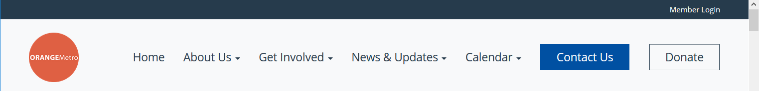
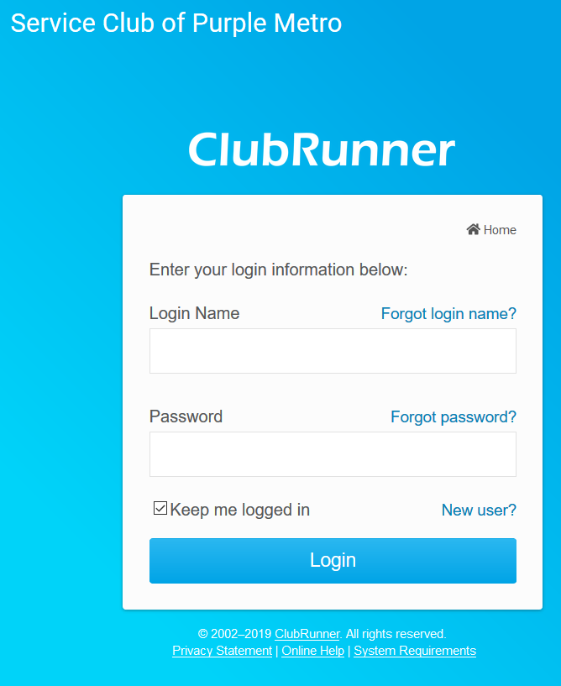
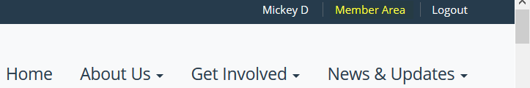
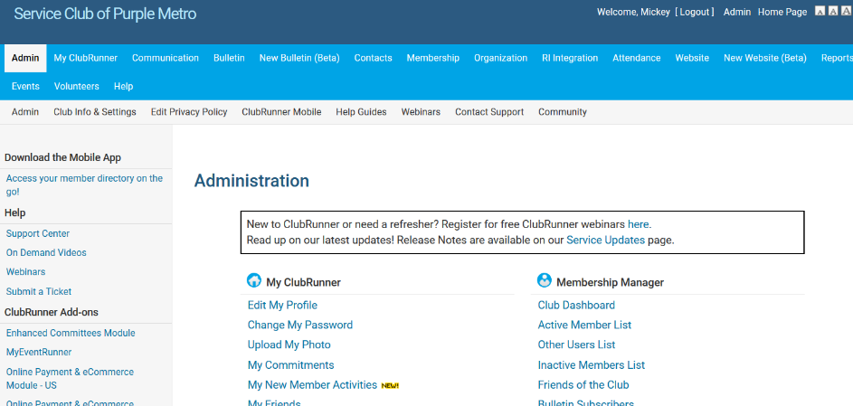
How do I login?
At the top right of your ClubRunner homepage, click the ‘Member Login’ button:
1
2
Input your pre-assigned login name and password:
3
Along the top click Member Login to login to the Administration page:
Help article: How do I login?

Slide 4
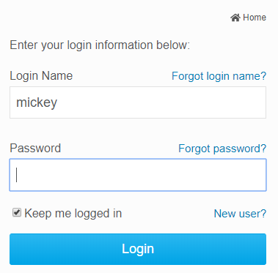
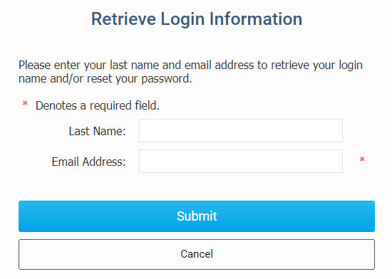
How do I retrieve my login?
If you don’t know, or don’t remember, your login & password then click the blue Forgot? Buttons.
Now input your last name and email address. An automated login retrieval email will be sent to you. If you still are unable to login, for further assistance please send an email to: logins@clubrunner.ca
1
2
Help article: I Cannot Login to ClubRunner

Slide 5
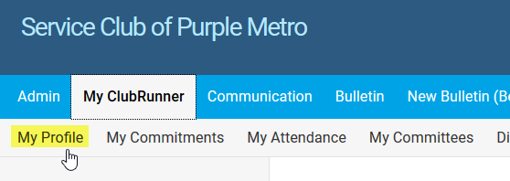
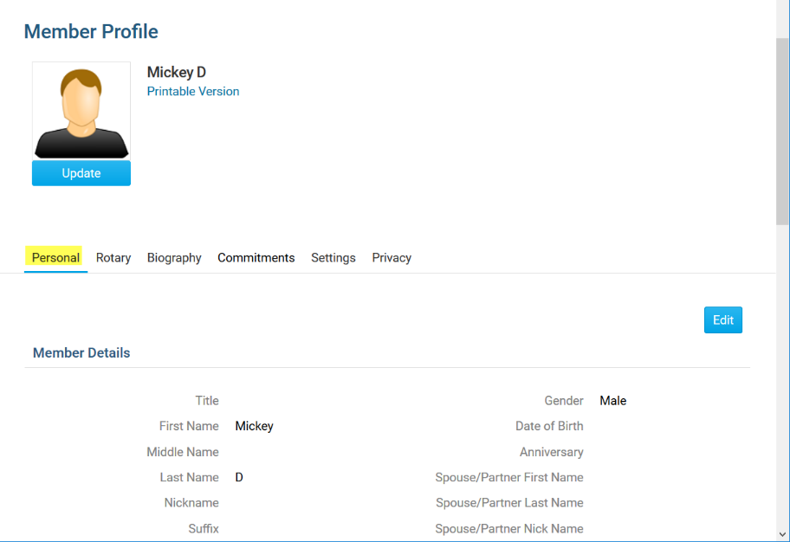
How do edit my profile?
Along the top tabs click
MyClubRunner - My Profile:
Inside your profile, below your photo, there are several tabs such as:
Personal | Rotary | Biography | etc. Select any of these tabs. These tabs contain all the different sections of your profile you can edit. Click the Edit button to edit your information.
1
2
Help article: How do I access & change my profile information?

Slide 6
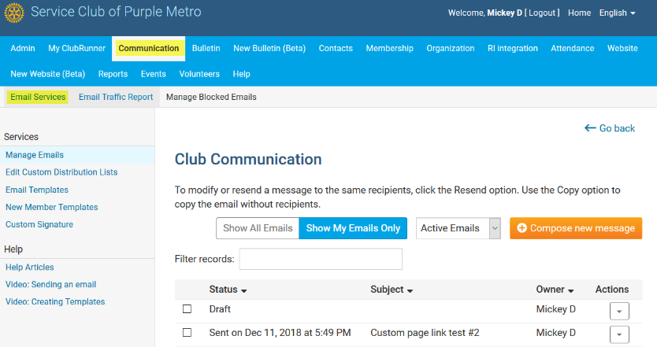
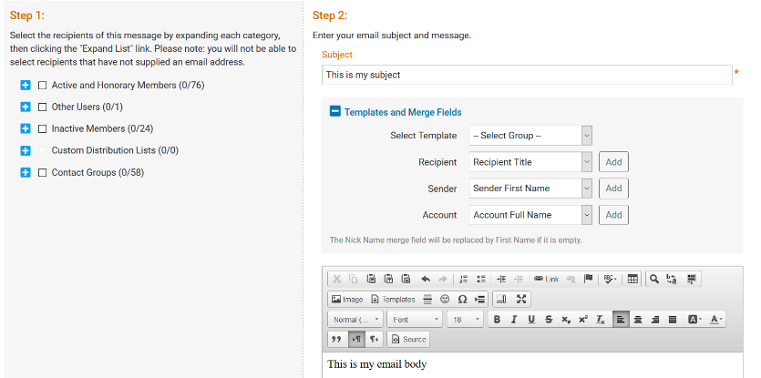
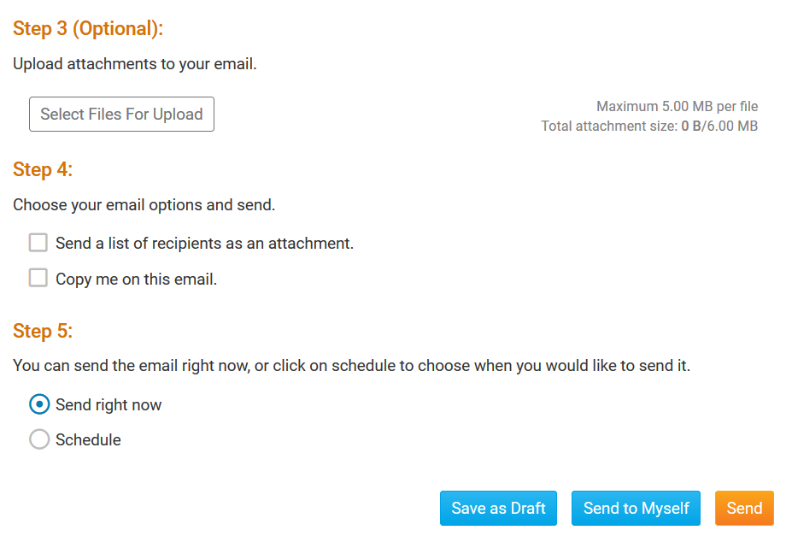
How do I send email?
1
2
3
Along the top tabs click:
Communication – Email Services, then
Compose new message.
Step 1 = select your recipients
Step 2 = compose the subject and body of email
Step 3 = add attachment
Step 4 = send a list of recipients; cc yourself
Step 5 = send now, or schedule email for later
Help article: How do I send email?

Slide 7
How do I access reports?
Along the top tabs click the Reports tab to reveal the reports we have:
Available reports include:
edirectory Reports 2.0 - a collection of printable member reports in PDF and MS Word format
edirectory Builder 2.0 - create your own printable member reports
Club Dashboard - various membership reports that automatically update monthly
Years of Service - how many years of service each member has contributed to Rotary
Age Distribution - age demographic breakdown of your club
Gender Distribution - gender demographic breakdown of your club
Rule of 85 - members in your club who qualify as Rule of 85, sometimes called Senior Active
Birthdays & Anniversaries - member and spouse birthdays and anniversaries
Login Activity - which members have logged into the website Member Area, and when
Download Member Data - create custom MS Excel files using all member data that we store
Member Activity - a breakdown of member’s activities and participation in the club
Club Activity - Overall member participation, including events and club activities at a glance
Help article: Reports Help section

Slide 8
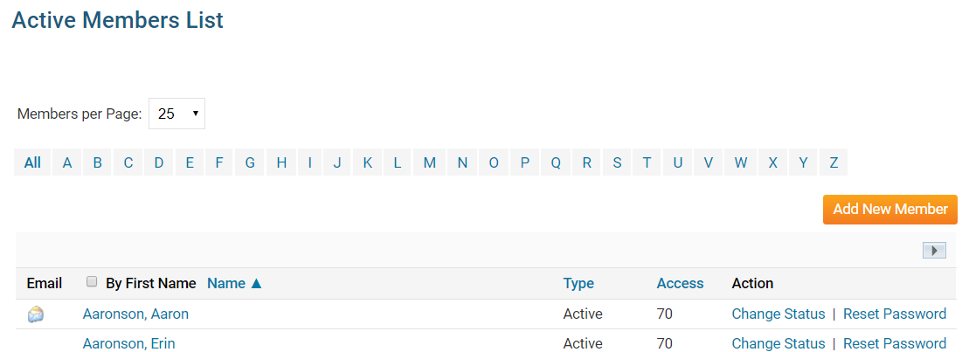
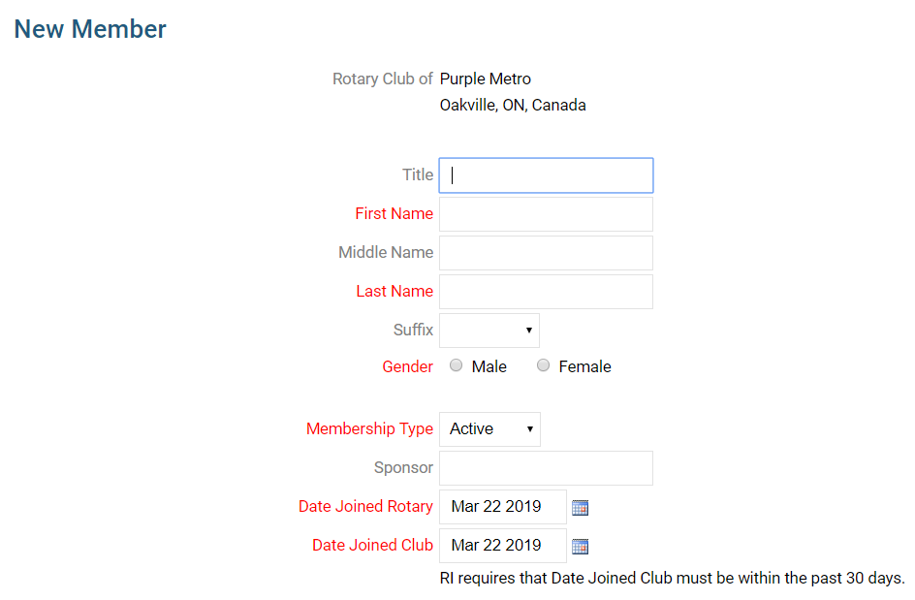
How do I add a new member?
1
Along the top tabs click Membership – Member Lists:
2
In the Active Members List click the orange Add New Member button
3
Fill in all appropriate information. Fields marked in red are required.
Note that these are the minimum required fields, you can input more information later.
Help article: How do I add a new member?

Slide 9
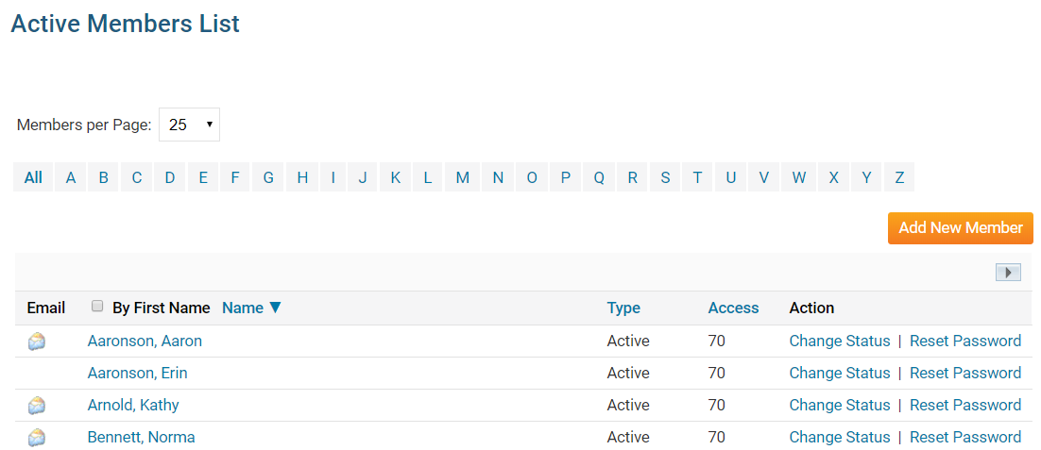
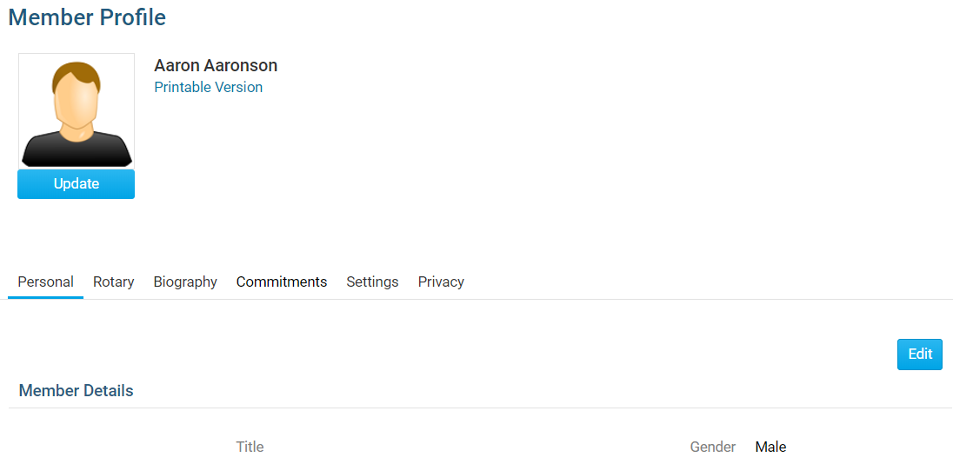
How do I edit an existing member?
1
Along the top tabs click Membership – Member Lists:
2
In the Active Members List click on any member’s name in blue.
3
This takes you to the member’s profile. Change any information by clicking the Edit button.
Note: on the club website only members with access
levels of 50, 40 and 30 can edit other member profiles.
Help article: What is The Member Profile & How Do I Edit It?

Slide 10
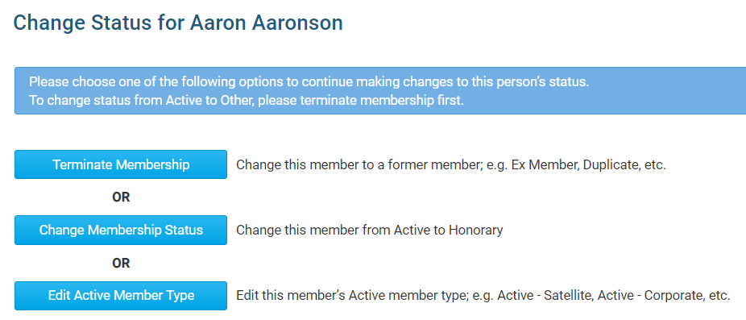
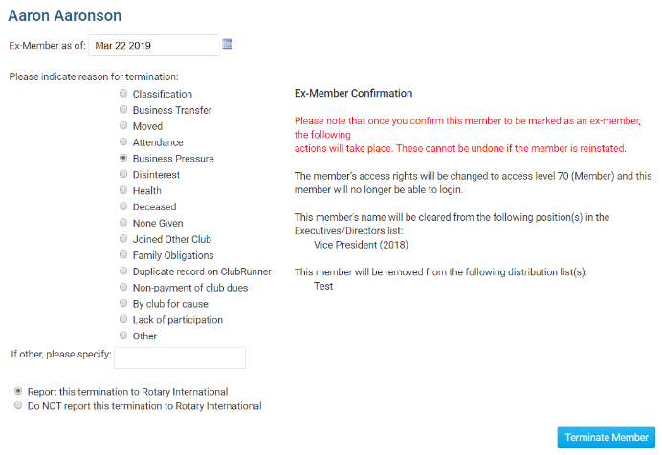
How do I terminate a member?
1
Along the top tabs click Membership – Member Lists:
2
In the Active Members List click on Change Status beside any member’s name.
3
On the Change Status screen click
Terminate Membership
4
You must choose a reason for termination to activate the blue Terminate Member button.
Except in special cases, always choose Report this termination to Rotary International.
Help article: How do I terminate or delete an active member?

Slide 11
Help Resources
www.ClubRunnerSupport.com
support@clubrunner.ca
1-877-469-2582

