Slide 1
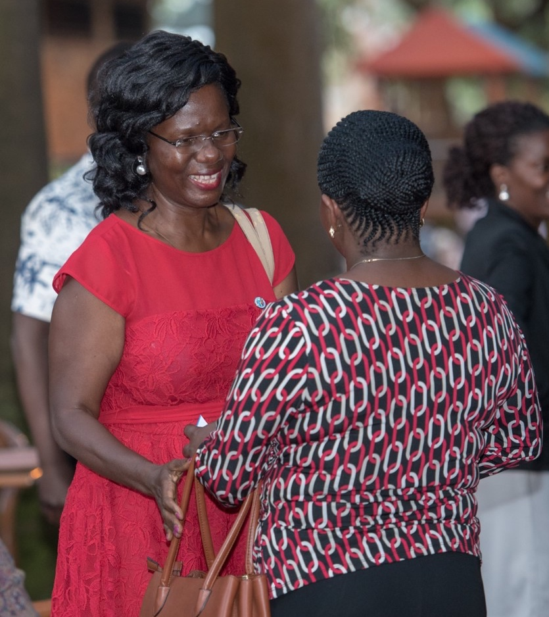
Reach Out
Ask if you can attend your local Rotary club meeting
Welcome a Rotarian who visits your Toastmasters club meeting
Invite a Rotarian to be a guest speaker at your club meeting
Notes:
(Please note: This slide and the previous slide are the same except for the in-person focus of this slide and the online focus of the previous slide; please choose the appropriate slide to include in your presentation.)
You can reach out to your local counterpart club. For example, you can :
•Visit a Rotary club meeting – Ask club leaders if you can attend as a guest – online or otherwise- to observe how it works. Stay afterward and introduce yourself. You could invite a member to attend your club meeting as well
•Welcome Toastmasters who may visit your club to learn more about Rotary and Rotaract
•Invite a Toastmasters member to be a guest speaker at an upcoming meeting
There are a lot of possibilities for collaboration at the grassroots level.
While both Toastmasters International and Rotary International have communicated this alliance to its members, some clubs/members may still be unaware. If you reach out and find that is the case, help spread the word by sharing the information you have and directing them to the website listed at the end of this presentation.
If there isn't a club near you, Toastmasters members can still get involved by learning about Rotary, connecting to an online community, or creating My Rotary account to access online courses on topics Rotary has expertise in.

Slide 2
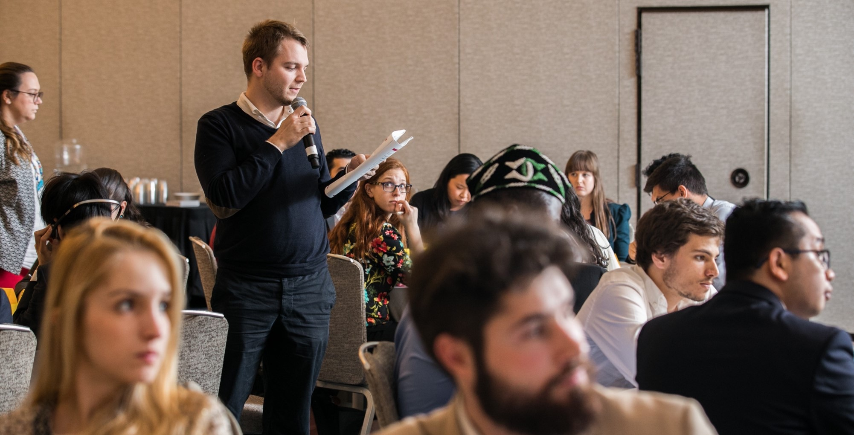
Cross-Training Opportunities
Notes:
Many clubs and Districts around the world are already teaming up with their local Rotary or Rotaract clubs in various ways.
Some have invited each other to their district-training events to be speakers or trainers. For example, one Rotary training-event organizer invited a Toastmasters member to lead a public-speaking workshop for their incoming district leaders.

Slide 3

Collaboration
Leadership development programs
Cross-mentor pairs
Social or networking events
Notes:
Some club and district leaders are getting together with their local Rotary or Rotaract club and district leaders to discuss ways they could work together to benefit their members, including
Toastmasters members hosting Rotary and Rotaract members who are working on their public-speaking skills and providing expert evaluations
Developing a cross-mentor program where Toastmasters can pair up with Rotarians and Rotaractors to share expertise
Holding a social or networking event so that members of both clubs or districts can connect ad expand their networks
NOTE: Rotary and Toastmasters clubs are a lot alike: each club is autonomous and determines its own activities and priorities to reflect their members’ interests and the community’s needs. If a Rotary or Rotaract club doesn’t have the capacity or interest in working together, there may be another club nearby that would be a better fit.

Slide 4
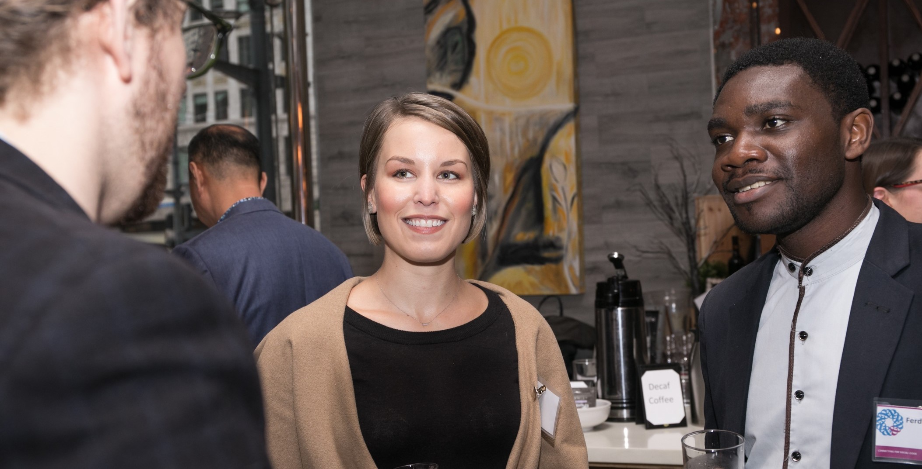
Dual Members
Notes:
There are many Toastmasters members who are also active Rotary or Rotaract members. If you have members in your club who also belong to Rotary, leverage their expertise and experience. They have amazing stories to tell about projects they have worked on. There are also topics that club leaders on both sides can relate to, such as attracting and engaging members, new-member orientation, and preparing your successor. Our alliance makes it possible to benefit from the expertise of each other's organizations without joining.

Slide 5
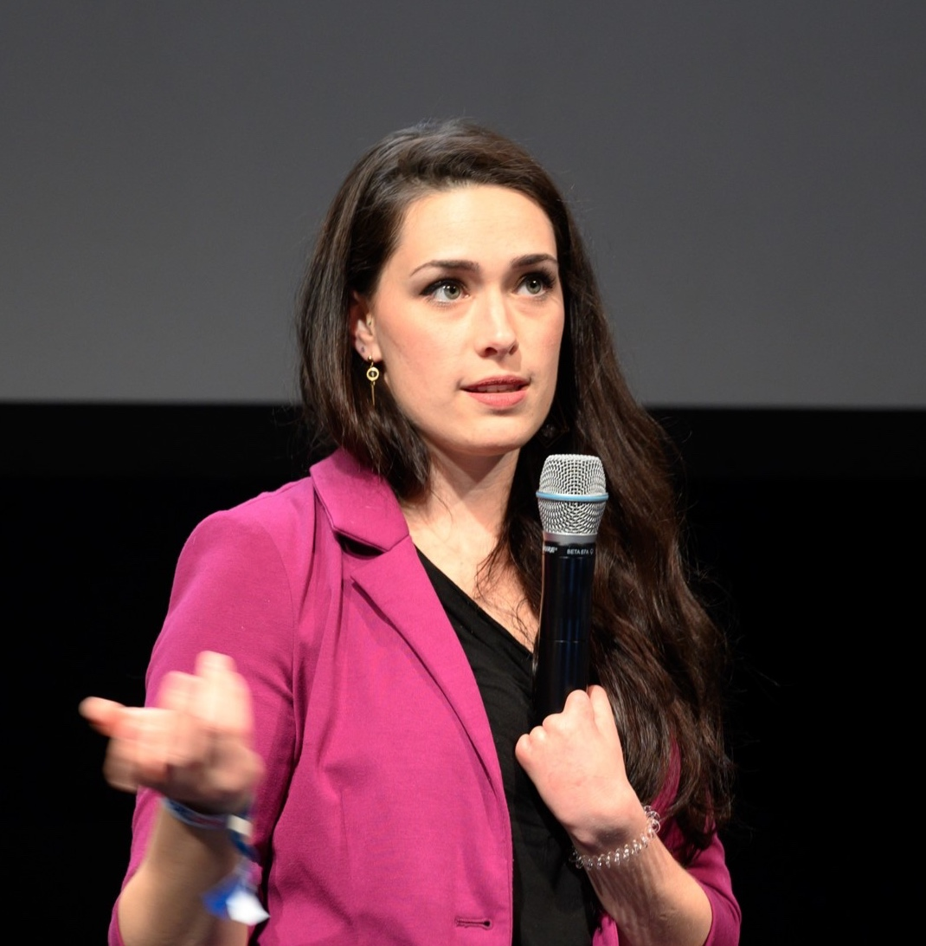
Source Your Speakers
If you are looking for speakers for meetings or events, consider your local Rotary or Rotaract club.
Notes:
When your club needs a guest speaker for an event, or a test speaker for a contest, invite a local Rotarian. Rotary members welcome opportunities to share their Rotary stories.
Offer to be a speaker at a Rotary district conference or training event to share your expertise. Be sure to ask the organizer what they would like you to speak about.

Slide 6
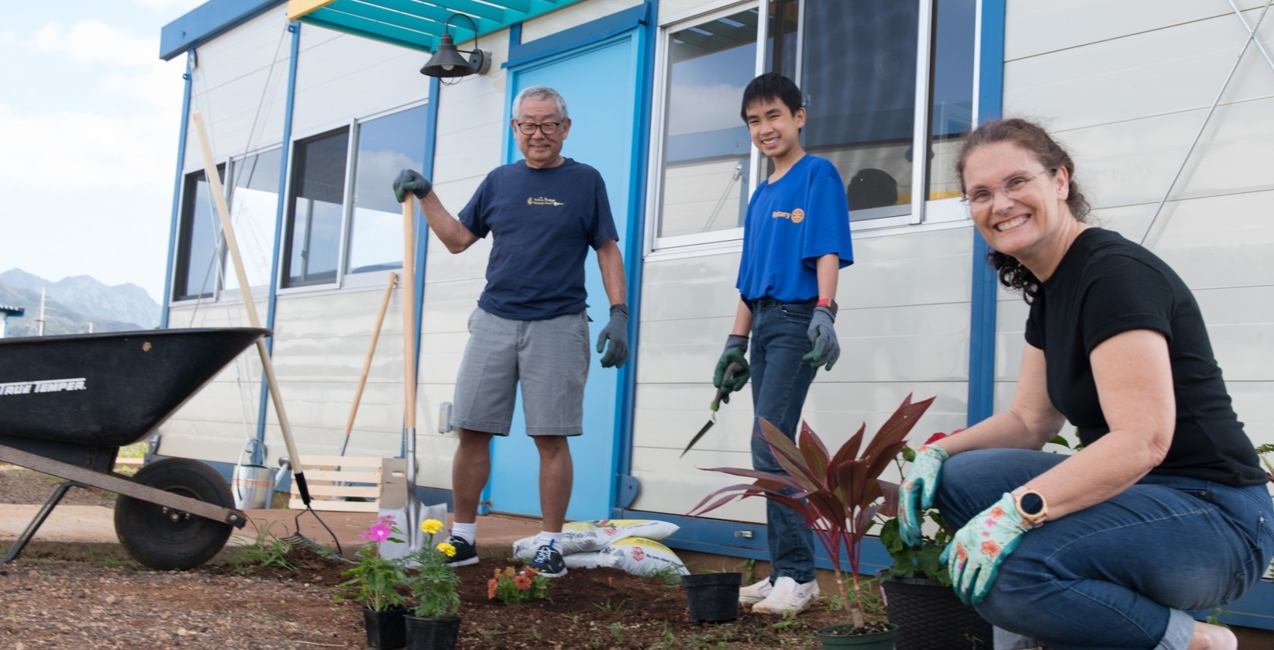
Participate in
Service Projects
Notes:
Finally, you could put your leadership and public-speaking skills toward a good cause by getting involved in Rotary service projects. Talk to your local Rotary club leaders to see how you might be able to participate, and whether there is a Rotary Community Corps in your area.

Slide 7




The Alliance
Learn More
Get Involved
Notes:
Today we’ve talked about the goals of the alliance, learned more about Rotary, and shared ways you can get involved.

Slide 8
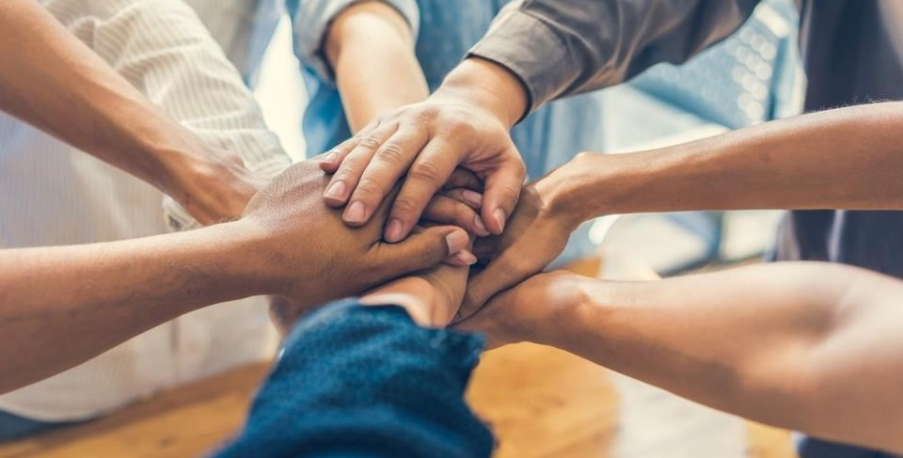
www.toastmasters.org/rotary
Notes:
Learn more by visiting toastmasters.org/rotary. There you can find:
•An overview of the alliance
•FAQs and other resources

Slide 9
Questions?
Email: rotaryalliance@toastmasters.org
Notes:
What questions do you have?
You can send any questions about the alliance to rotaryalliance@toastmasters.org.

